Slide 1

Uncertainty Quantification (in ML)
Rayid Ghani

Slide 2
Reminders
Coming up:
Classes
Uncertainty Quantification (today)
Temporal Drift and Distribution Shift (Thursday)
ML Ops (next week)
Assignments
Submit your updates anytime before Dec 2 to get full points
Module 2 assignment due Dec 2
Presentations on Dec 2 and 4 (will announce slots Thursday – randomly assigned)
Final reflection writeup due Dec 10

Slide 3
Scope
Data
Exploration
Modeling
Get Data
Store Data
Link Data
Rows
Features
Labels
Model Selection
Train-Test Splits
Performance Metrics
Model Interpretation
Entities
temporal
Spatial
…
Models
Dealing with Bias and Fairness
Field Trial Design
Deployment
Monitoring
Goals, Actions, Data, Analysis, Ethics

Slide 4
Focus of today
What is uncertainty quantification
Why do we care
Sources of uncertainty
How to get it
What do we do once we have it

Slide 5



Do not edit How to change the design
Why do we care about uncertainty quantification in ML models and predictions?
The Slido app must be installed on every computer you’re presenting from

Slide 6
Why do we care about uncertainty quantification in ML?
Helpful in moving from prediction to action/decision
Helpful in chaining together multiple models
Generally model selection
Allows human in the loop in a systematic way

Slide 7
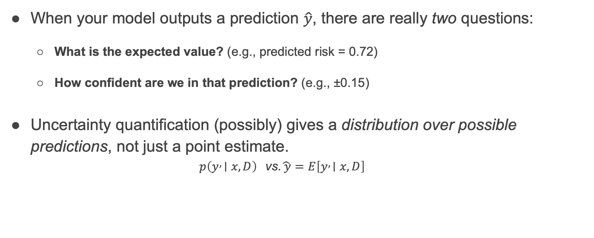
What do we mean by Uncertainty in a Prediction
When your model outputs a prediction $\hat{y}$, there are really two questions:
What is the expected value? (e.g., predicted risk = 0.72)
How confident are we in that prediction? (e.g., ±0.15)
Uncertainty quantification (possibly) gives a distribution over possible predictions, not just a point estimate.
$$p\left(y , ∣x,D\right) \text{vs}\text{.} \hat{ y}=E\left[y , ∣x,D\right]$$

Slide 8
Most ML models do not provide non-trivial uncertainty estimates
Out of the box ML models typically provide a point estimate
Often between 0 and 1
Not calibrated to be a probability

Slide 9
Do not edit How to change the design
What are some of the underlying sources of uncertainty in our models?
The Slido app must be installed on every computer you’re presenting from

Slide 10
Types of uncertainties
Wrong model or hyperparameters – model uncertainty
Quality and amount of data – learning uncertainty

Slide 11
Sources of uncertainty
Type | What it means | How to estimate it
Aleatoric | Noise inherent in data (cannot be reduced) | Use probabilistic output layers or quantile/conformal prediction
Epistemic | Model uncertainty from limited data or parameters | Use ensembles, Bayesian or dropout-based methods
Distributional / Shift | Uncertainty due to unseen data distributions | Evaluate predictive confidence on OOD inputs
Label / Annotation | Disagreement in human labels | Model label distributions or soft labels

Slide 12
Aleatoric Uncetainty
Due to random process or stochastic characteristics in a system
More data does not help
Fun question: where does the word Aleatoric come from?

Slide 13
Epistemic Uncertainty
Due to lack of information or knowledge about …
(Less) Fun question: where does the word Epistemic come from?

Slide 14
How can we estimate uncertainty?
Inherent models
Post-hoc approaches

Slide 15
Group Activity
How would you take your existing models (or build new models) to generate uncertainty estimates for each of your top k predictions?
How would you evaluate those uncertainty estimates?

Slide 16
Post-hoc approaches
Resampling
Model Ensembles
Calibration

Slide 17
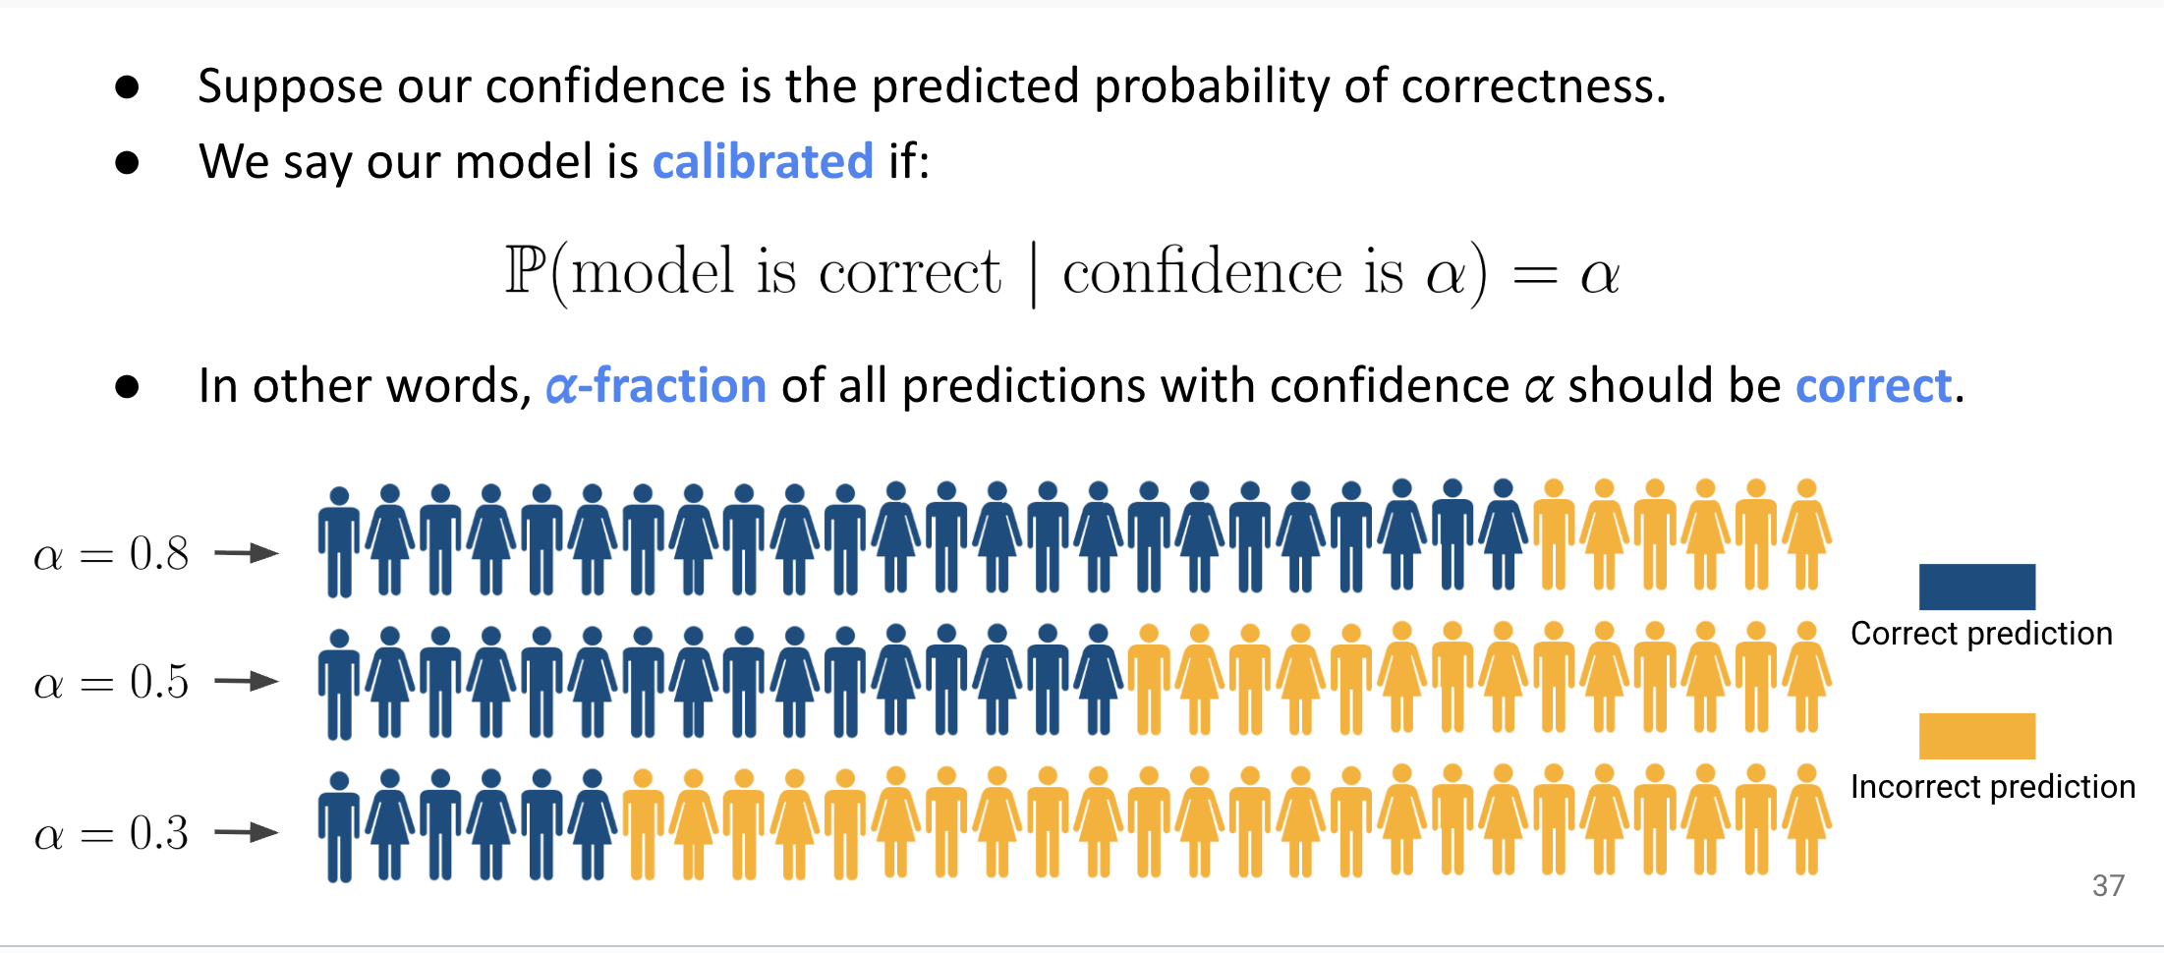
Ways to get uncertainty estimates: Calibration

Slide 18
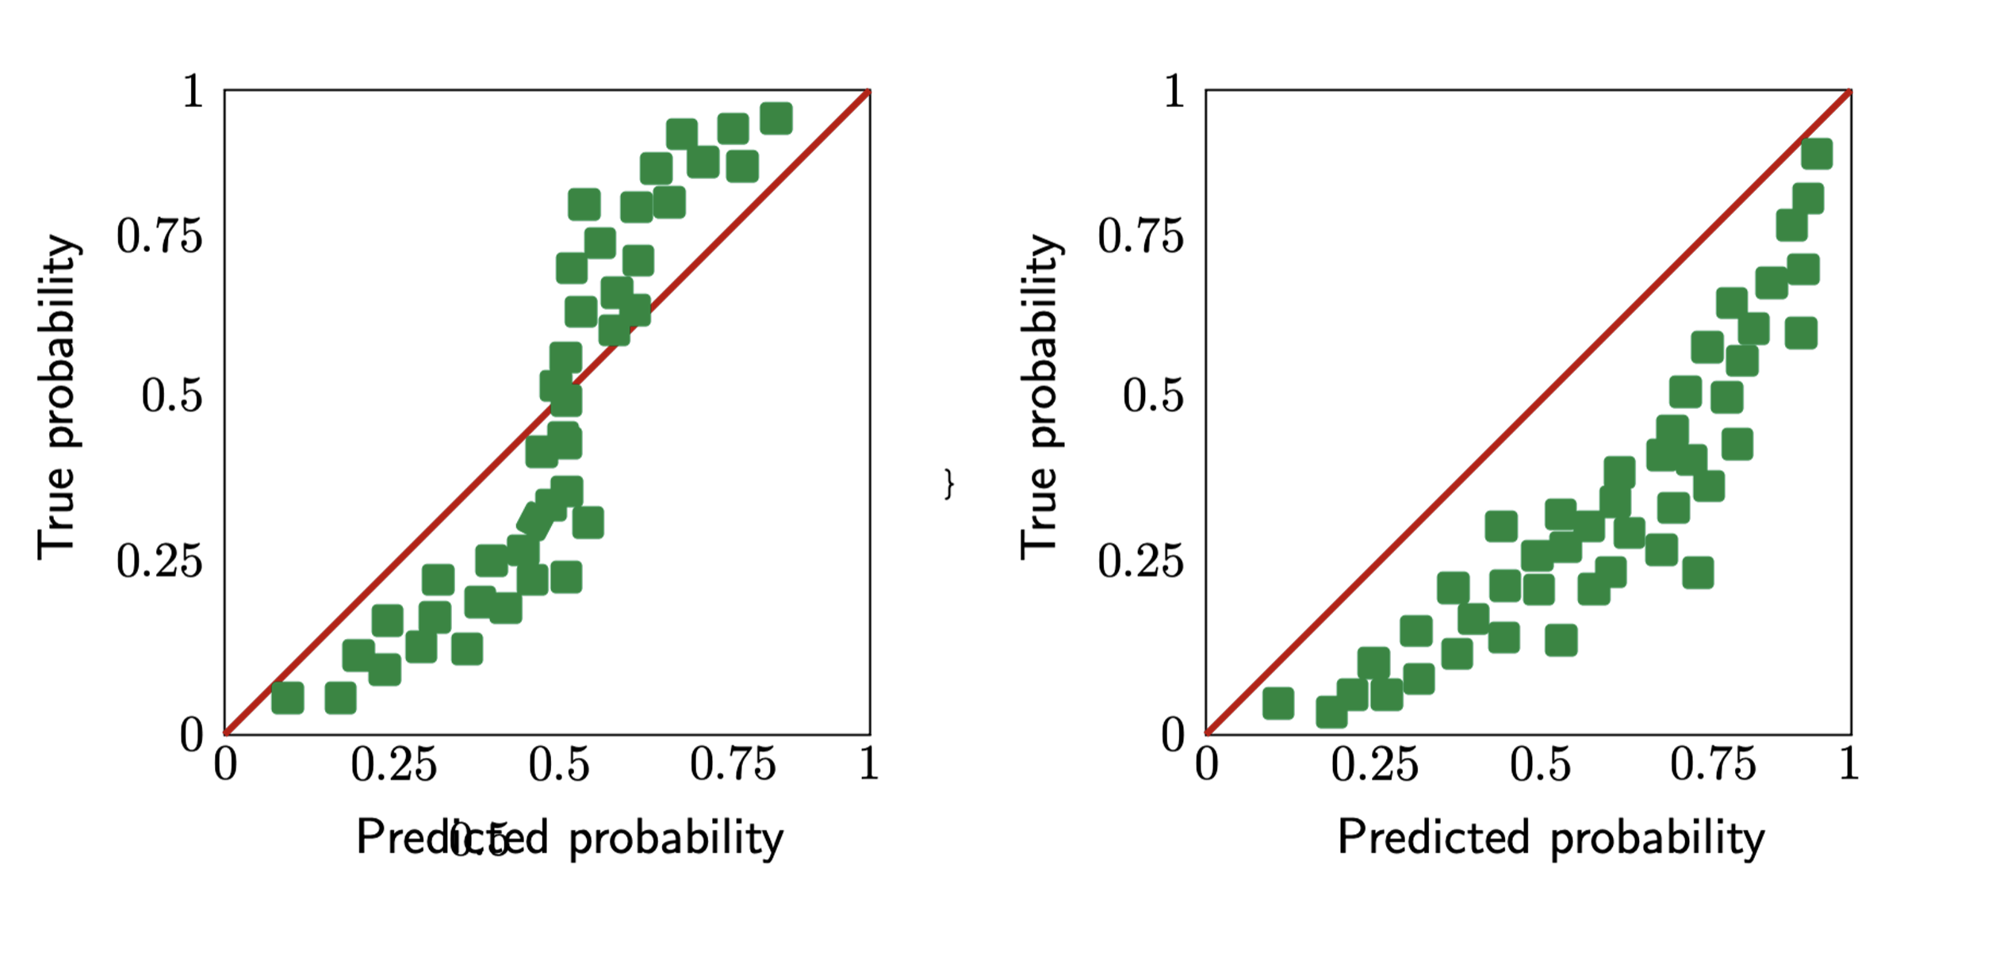
Ways to get uncertainty estimates: Calibration

Slide 19
Generic approach to calibration
Train a model f on an initial training set for whatever primary objective.
Define your event of interest (that you are predicting the probability of).
Obtain uncalibrated model predictions f(x) on a heldout calibration set.
Tune a calibration model f’(f(x)) on the primary model’s uncalibrated predictions.
Measure resulting expected calibration error of f’ on a heldout test set.
Deploy both f and f’ for predictions and confidence estimates, respectively. (Although, often the argmax will be unchanged for most calibration models.)
(From Tutorial: Uncertainty Estimation for Natural Language Processing)

Slide 20
Conformal Prediction for uncertainty quantification
P(true label is within predicted set) > 95%
1. (for each example in calibration set) Get score of correct label
2. Take 5% quantile of that score (At least 95% of the examples have score >= q)
3. Output all labels/classes where score >= q

Slide 21
DonorsChoose: Do our models have a notion of confidence?
Yes or no?
If yes
what is it? For which models?
Have we validated if it’s correct?

Slide 22
What could we do with uncertainty estimate?
Reject recommendations
Reorder - stratify
Provide set valued outputs (for multiclass problems)
Use to estimate expected values
Build or reduce trust in certain pointwise predictions…
Identify areas of improvement for a given model (e.g., for active learning
Produce more natural responses (that reflect confidence) for dialogue agents…
Abstain from making predictions when in doubt…

Slide 23
Additional resources
https://lss.fnal.gov/archive/2025/slides/fermilab-slides-25-0197-etd.pdf
https://www.ibm.com/think/topics/uncertainty-quantification
https://yazokulu.bilimakademisi.org/yapayogrenme/2021/slides/Sensoy.BAYOYO2021.pdf
https://www.afit.edu/STAT/statcoe_files/4_0328_LazarusUQBP_2_2.pdf
https://arxiv.org/pdf/1910.09457
Tutorial: https://sites.google.com/view/uncertainty-nlp
https://neurips.cc/media/neurips-2020/Slides/16649.pdf
Kull, M., & Flach, P. (2014). Reliability maps: A tool to enhance probability estimates and improve classification accuracy. In Proceedings of ECML/PKDD, European conference on machine learning and principles and practice of knowledge discovery in databases, Nancy, France, pp. 18–33.

